Slide 1

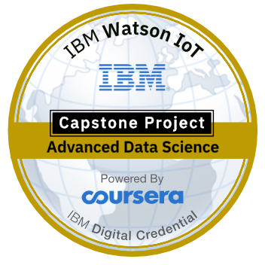
Tractor Dealer Finder and Guide for Pune Location
IBM Capstone project.

Slide 2
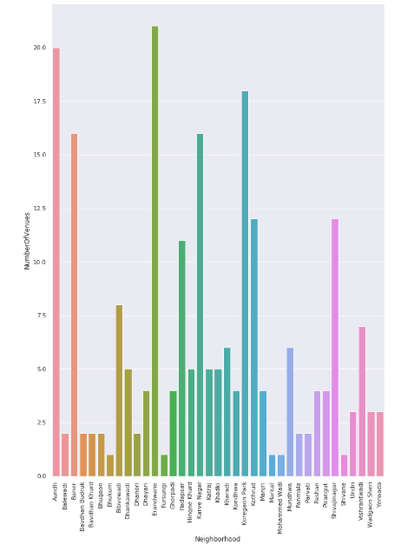
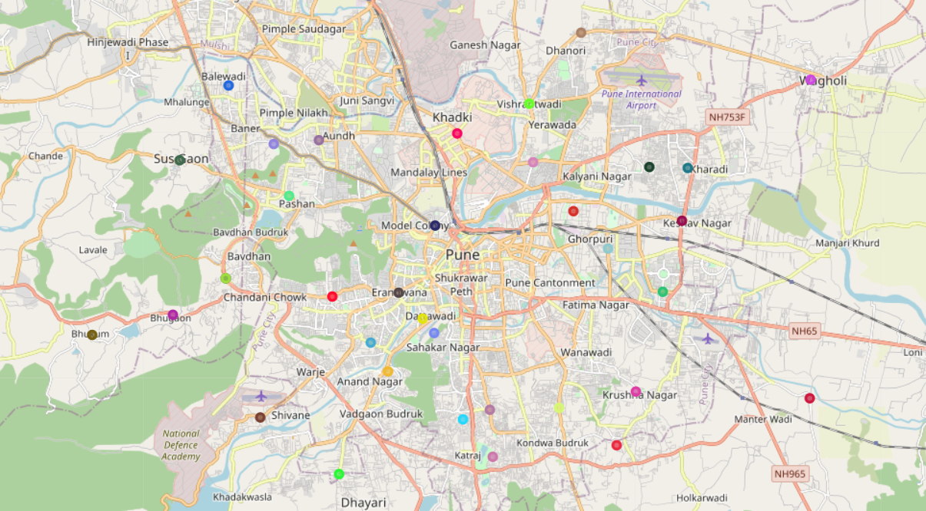
Project Approach & Methodology
Dealer Guide
Machine learning
Exploratory analysis
Inferential analysis
Number of venues per Neighborhood in Pune
Neighborhood locations in Pune show in map with folium

Slide 3
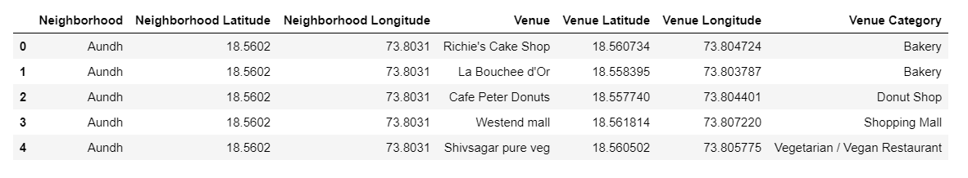
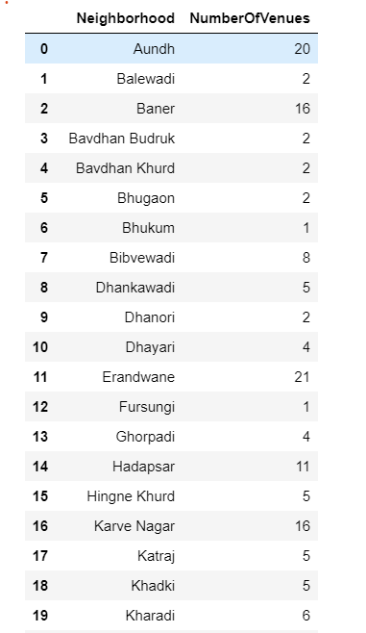
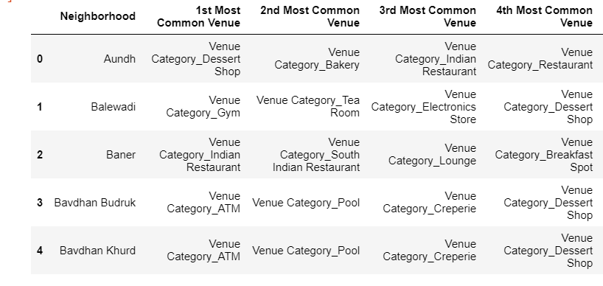
Input and Edited Data
Venues extracted from Foursquare for each neighborhood
Frequency of most common venues in each neighborhood
Number of venues per neighborhood

Slide 4
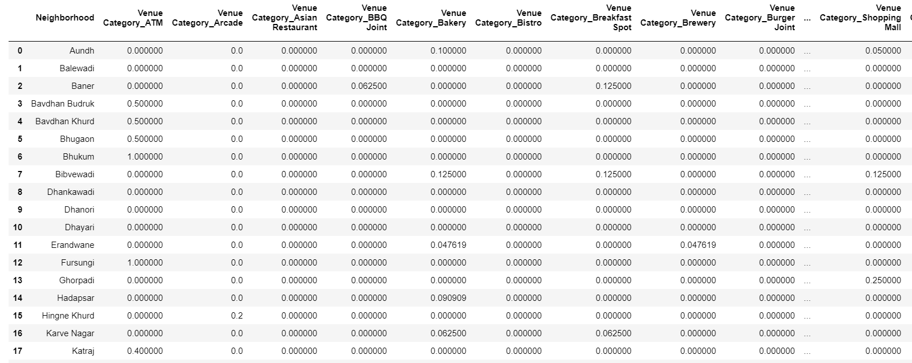
Input and Edited Data
Each distinct type of venue mapped against each neighborhood.
Distinct types range from – bakeries, to sports bar to veg/non-veg restaurants etc.

Slide 5
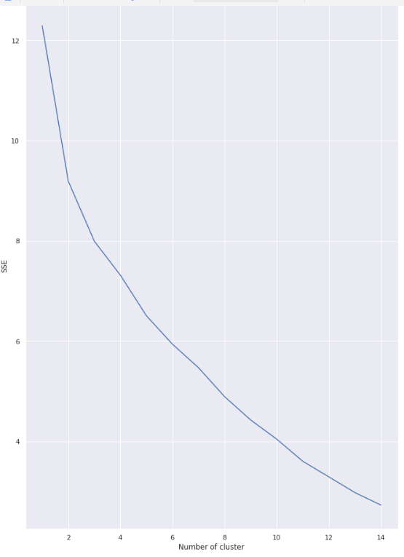

kMeans approach to find the optimal number of clusters
Number of venues per Neighborhood in Pune

Slide 6
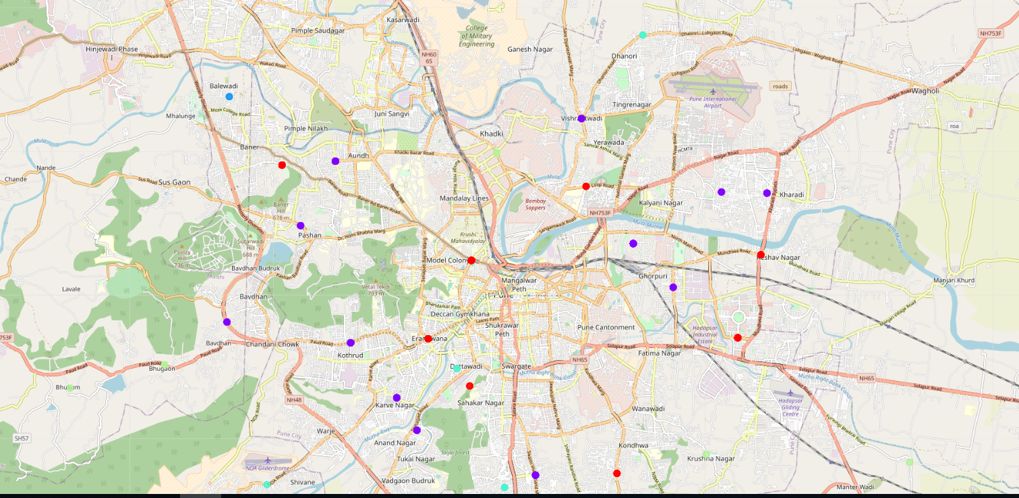
Cluster of Neighborhoods based on population of each neighborhood

Slide 7
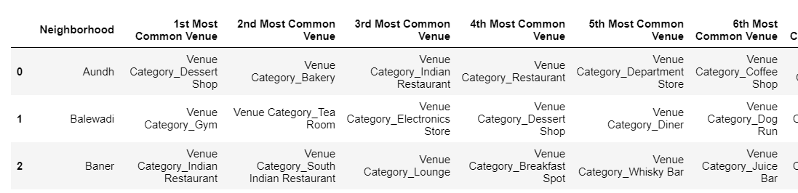
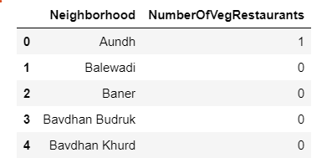
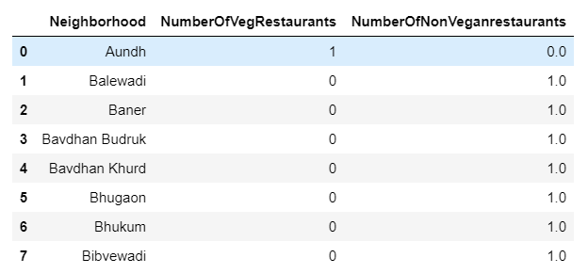
Conclusion
Most common venues for each neighborhood were found out
Also, as shown in below picture, user can be guided to specific locations based on his/her specific inputs

Slide 8

Thank You!

